Slide 1

Public Relations- May- April 2021

Slide 2
PR Objective for Suguna Foods
To create visibility for Suguna Foods’ spokesperson on Industry developments.
To build the brand image for Suguna Foods
To increase the awareness among consumers pan India on the benefits of Chicken.
To identify influencers who can advice on the immunity boost factor with regard to chicken and share the diet chart for all age groups.
To create awareness on the ideal bird weight for consumption- 1.7-2kgs.
To create stories on Vitamin D eggs and its benefits during Covid19
To create positive chicken stories and influence consumers indirectly to consume chicken thrice a week.
To enhance the protein richness that comes with chicken and eggs and creating awareness pan India
Chicken being safe to consume during Bird Flu crisis
The need to boost immunity during Covid Second Wave with the consumption of Chicken and Eggs

Slide 3
Coverage Report
Month | Total Coverage | Print | Online
March | 81 | 64 | 17
April | 87 | 61 | 26
May | 61 | 35 | 26
June | 34 | 20 | 14
July | 31 | 21 | 10
August | 24 | 16 | 8
September | 73 | 66 | 7
October | 51 | 42 | 9
November | 26 | 24 | 2
December | 33 | 20 | 13
January | 85 | 73 | 12
February | 20 | 10 | 10
March | 23 | 10 | 13
April | 50 | 36 | 14
Electronic Media | 16 | NA | NA
Radio | 1 | NA | NA
Total | 696 | 498 | 181

Slide 4
Activity Highlights
Activity Highlights
Press Release 15
Exclusive stories 16
Contributory Article-8
Influencer 37
Industry Stories -7

Slide 5
Activities | Deliverables | Achieved
Daily industry tracking (Four competitors) | Daily | Daily
Collateral development | One time | One time
Media/ Blogger/ Influencer interactions for industry stories, corporate and spokesperson | 20 | 60
 | 12 | 8
Press Release | 8 | 15
Total | 40 | 83

Slide 6
Coverage

Slide 7
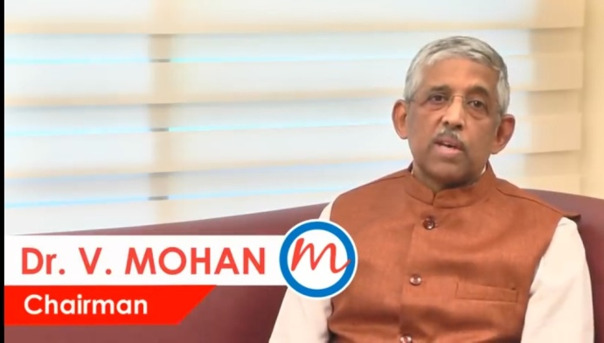

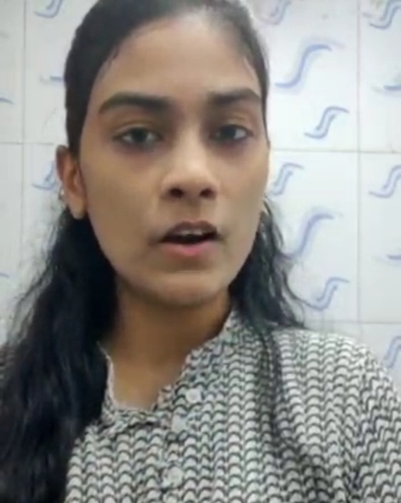
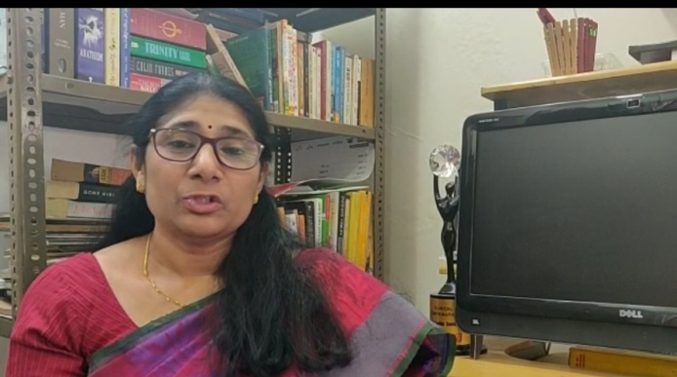
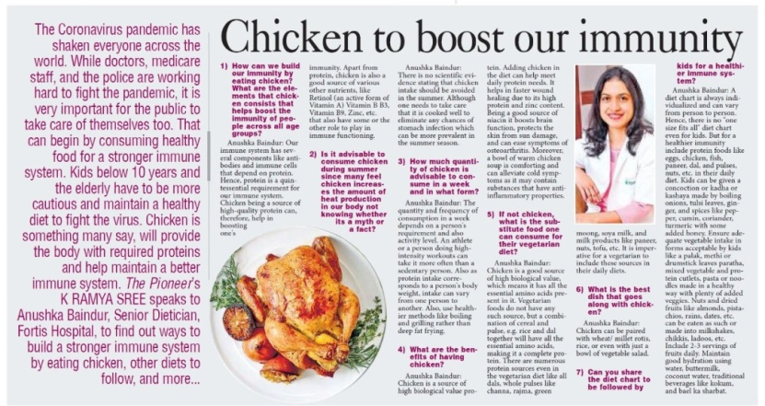
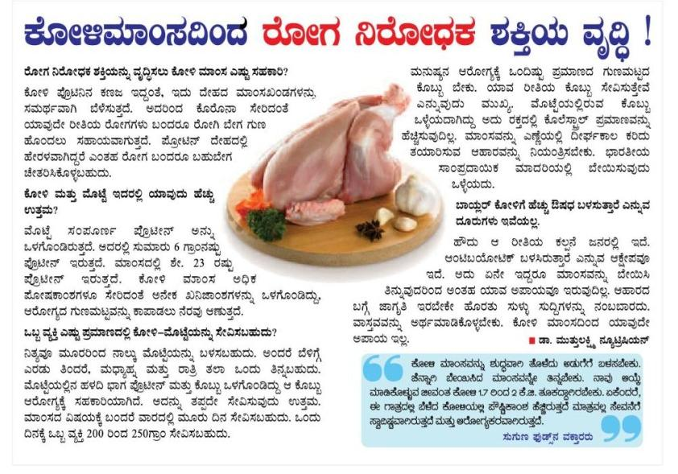
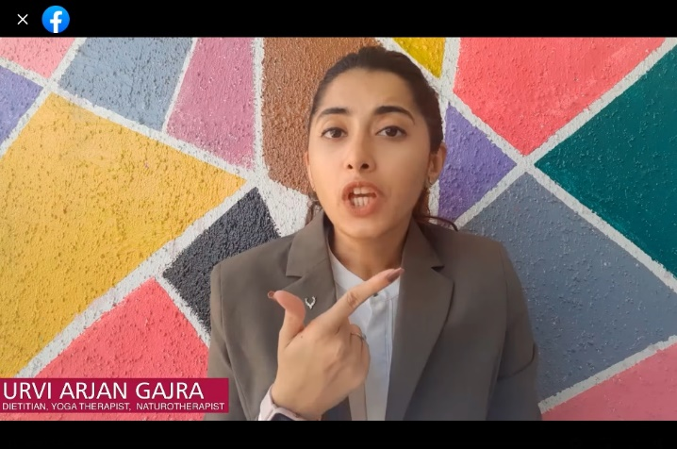
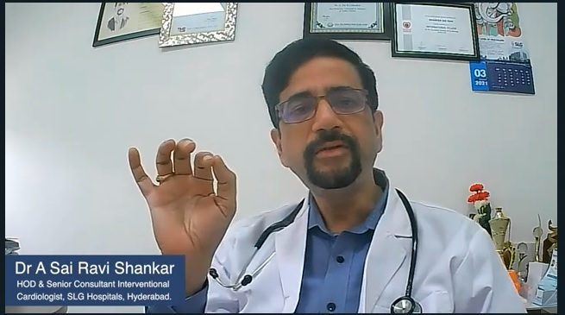
With Influencers

Slide 8
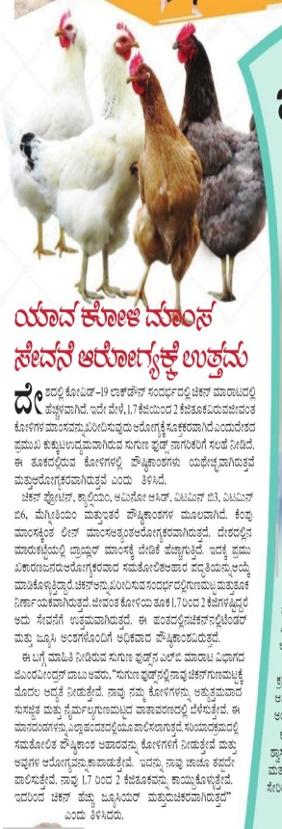
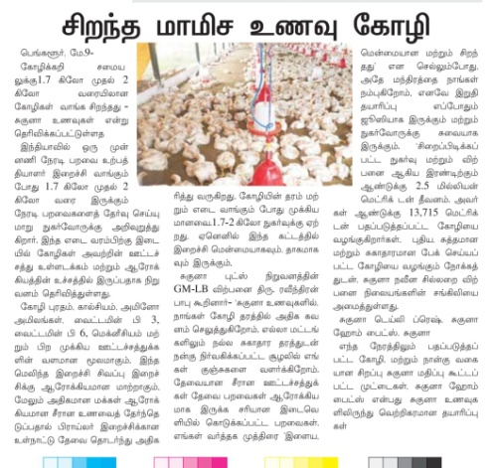
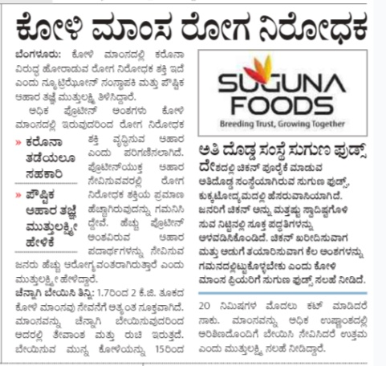
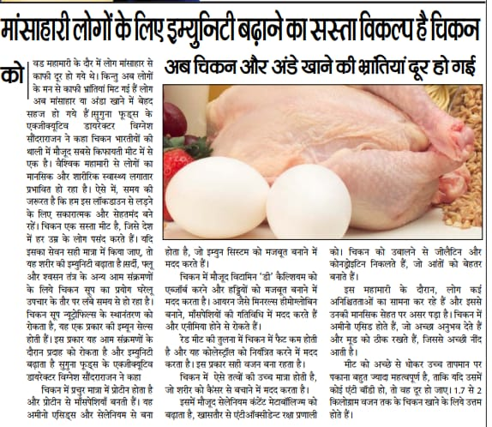
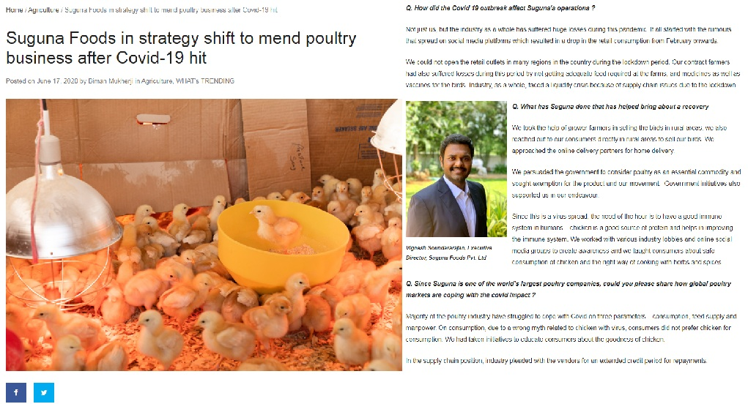
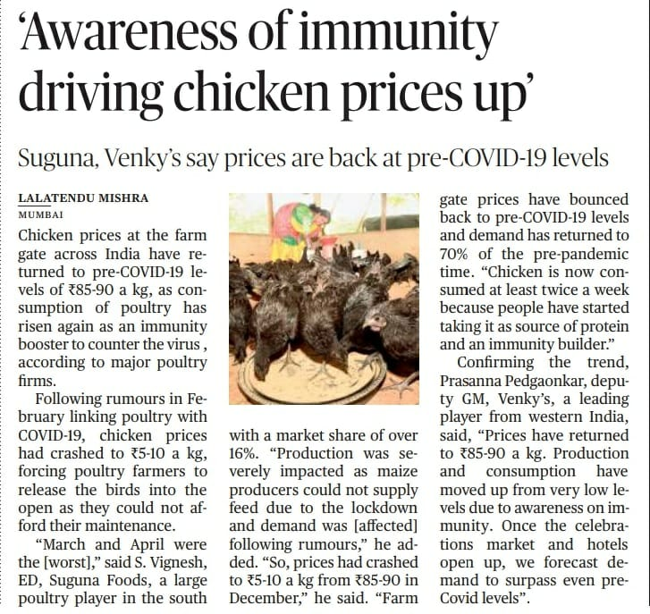
Sample coverage clips

Slide 9
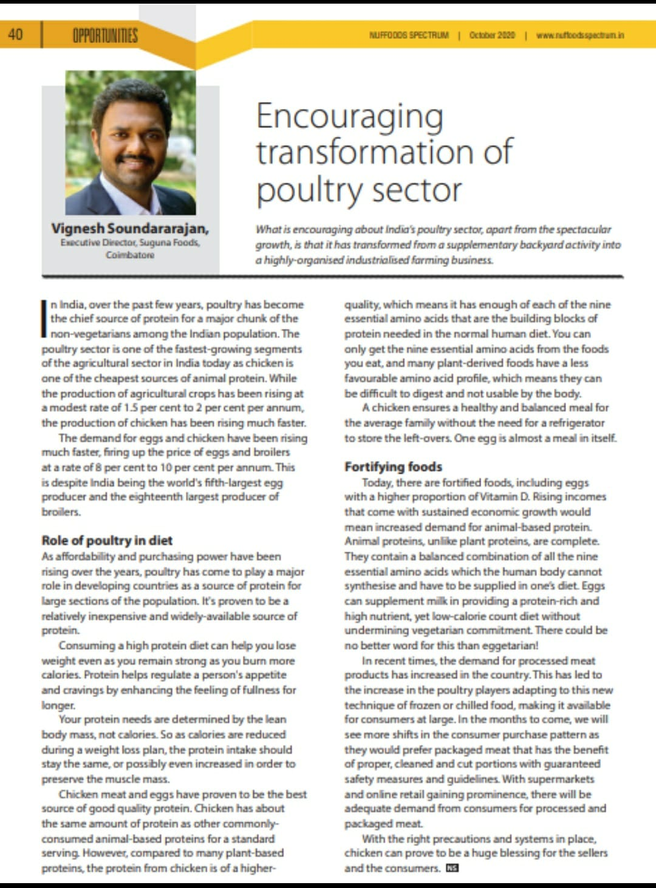
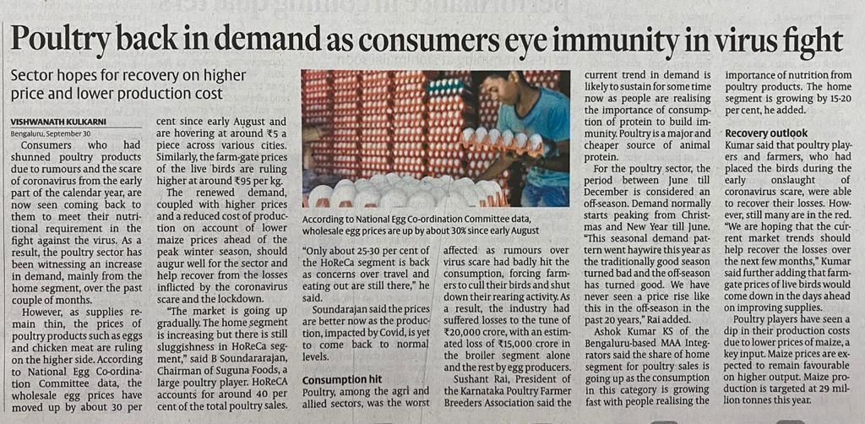
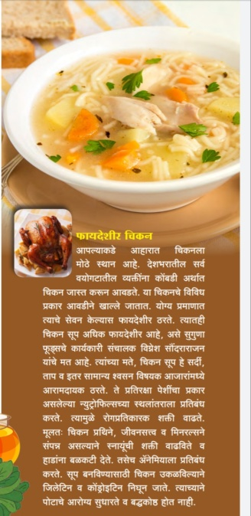
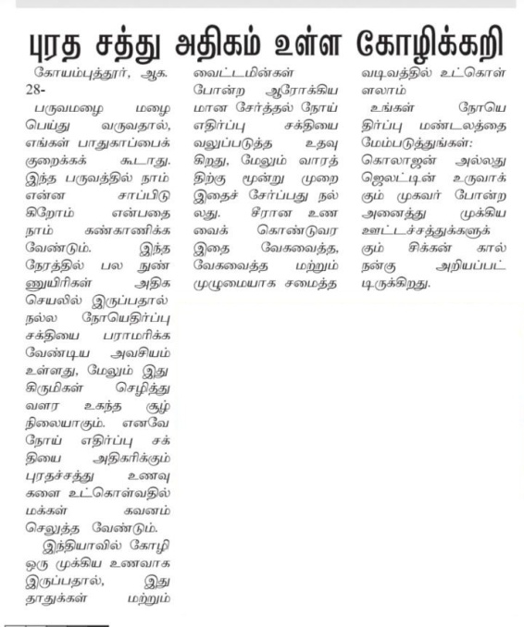
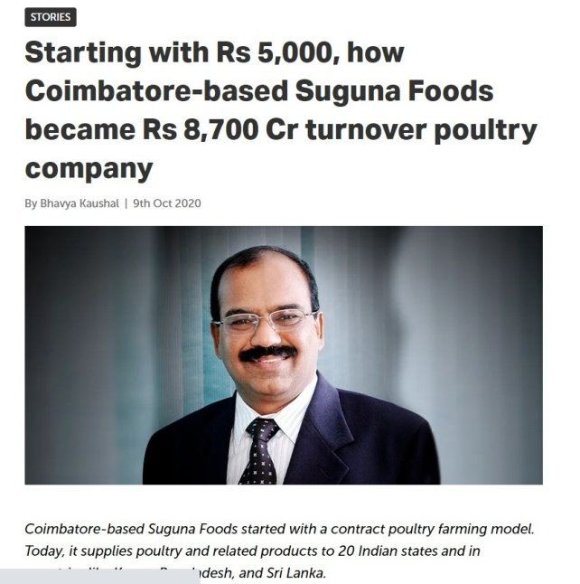
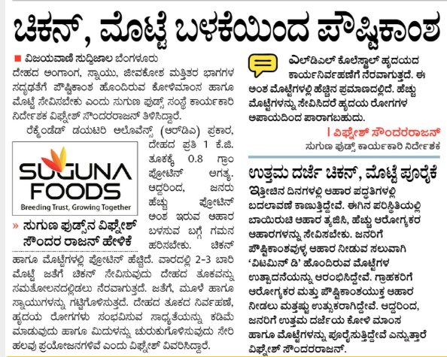

Slide 10
Thank You

